Slide 1
Prediction and Search in Probabilistic Worlds
Markov Systems, Markov Decision Processes, and Dynamic Programming
Andrew W. Moore Professor
School of Computer Science Carnegie Mellon University
www.cs.cmu.edu/~awm awm@cs.cmu.edu
412-268-7599
Copyright © 2002, 2004, Andrew W. Moore April 21st, 2002
Note to other teachers and users of these slides. Andrew would be delighted if you found this source material useful in giving your own lectures. Feel free to use these slides verbatim, or to modify them to fit your own needs. PowerPoint originals are available. If you make use of a significant portion of these slides in your own lecture, please include this message, or the following link to the source repository of Andrew’s tutorials: http://www.cs.cmu.edu/~awm/tutorials . Comments and corrections gratefully received.
Discounted Rewards
An assistant professor gets paid, say, 20K per year. How much, in total, will the A.P. earn in their life?
20 + 20 + 20 + 20 + 20 + … = Infinity
$ $
What’s wrong with this argument?
Copyright © 2002, 2004, Andrew W. Moore
Markov Systems: Slide 2

Slide 2
Discounted Rewards
“A reward (payment) in the future is not worth quite as much as a reward now.”
Because of chance of obliteration
Because of inflation
Example:
Being promised $10,000 next year is worth only 90% as much as receiving $10,000 right now.
Assuming payment n years in future is worth only (0.9)^{n} of payment now, what is the AP’s Future Discounted Sum of Rewards ?
Copyright © 2002, 2004, Andrew W. Moore
Markov Systems: Slide 3
Discount Factors
People in economics and probabilistic decision- making do this all the time.
The “Discounted sum of future rewards” using discount factor γ” is
(reward now) +
γ (reward in 1 time step) +
_{γ} 2
_{γ} 3
(reward in 2 time steps) + (reward in 3 time steps) +
:
: (infinite sum)
Copyright © 2002, 2004, Andrew W. Moore Markov Systems: Slide 4

Slide 3
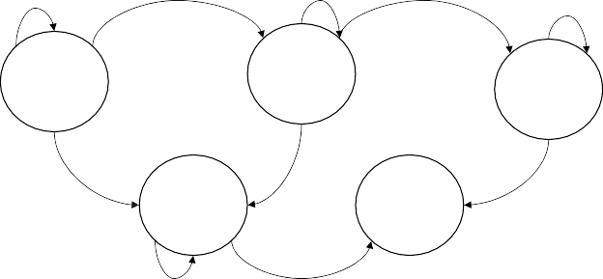
The Academic Life
0.6
0.2
0.6
0.2
0.7
A.
Assistant Prof 20
B.
Assoc. Prof 60
T.
Tenured Prof 400
0.2
S.
On the Street 10
0.2
D.
Dead 0
0.3
Define:
Assume Discount
0.7
0.3
Factor γ = 0.9
J_{A} = Expected discounted future rewards starting in state A J_{B} = Expected discounted future rewards starting in state B
J_{T} = | “ | “ | “ | “ | “ | “ | “ | T
J_{S} = | “ | “ | “ | “ | “ | “ | “ | S
J_{D} = | “ | “ | “ | “ | “ | “ | “ | D
How do we compute J_{A}, J_{B}, J_{T}, J_{S}, J_{D} ?
Copyright © 2002, 2004, Andrew W. Moore
Markov Systems: Slide 5
Computing the Future Rewards of an Academic
Copyright © 2002, 2004, Andrew W. Moore
Markov Systems: Slide 6

Slide 4
A Markov System with Rewards…
Has a set of states {S₁ S₂ ·· S_{N}}
Has a transition probability matrix
^{P}11 ^{P}12 ^{·· P}1N
P= P_{ij} = Prob(Next = S_{j} | This = S_{i} )
^{P}21
:
^{P}N1
··
^{P}NN
Each state has a reward. {r₁ r₂ ·· r_{N} }
There’s a discount factor γ . 0 < γ < 1 On Each Time Step …
Assume your state is S_{i}
You get given reward r_{i}
You randomly move to another state P(NextState = S_{j} | This = S_{i} ) = P_{ij}
All future rewards are discounted by γ
Copyright © 2002, 2004, Andrew W. Moore Markov Systems: Slide 7
Solving a Markov System
Write J*(S_{i}) = expected discounted sum of future rewards starting in state S_{i}
J*(S_{i}) = r_{i} + γ x (Expected future rewards starting from your next state)
= r_{i} + γ(P_{i1}J*(S₁)+P_{i2}J*(S₂)+ ··· P_{iN}J*(S_{N}))
Using vector notation write
J*(S₁) r₁
J*(S₂) r₂
^{P}11 ^{P}12 ^{·· P}1N
J= : R=
^{P}21 ·.
: P= :
r_{N}
J*(S_{N})
^{P}N1 ^{P}N2 ^{·· P}NN
Question: can you invent a closed form expression for J in terms of R P and γ ?
Copyright © 2002, 2004, Andrew W. Moore
Markov Systems: Slide 8

Slide 5
Solving a Markov System with Matrix Inversion
Upside: You get an exact answer
Downside:
Copyright © 2002, 2004, Andrew W. Moore
Markov Systems: Slide 9
Solving a Markov System with Matrix Inversion
Upside: You get an exact answer
Downside: If you have 100,000 states you’re solving a 100,000 by 100,000 system of equations.
Copyright © 2002, 2004, Andrew W. Moore
Markov Systems: Slide 10

Slide 6
Value Iteration: another way to solve a Markov System
Define
J¹(S_{i}) = Expected discounted sum of rewards over the next 1 time step.
J²(S_{i}) = Expected discounted sum rewards during next 2 steps J³(S_{i}) = Expected discounted sum rewards during next 3 steps
:
J^{k}(S_{i}) = Expected discounted sum rewards during next k steps
J¹(S_{i}) = | (what?)
J²(S_{i}) = | (what?)
: J^{k+1}(S_{i}) = | (what?)
Copyright © 2002, 2004, Andrew W. Moore
Markov Systems: Slide 11
Value Iteration: another way to solve a Markov System
Define
J¹(S_{i}) = Expected discounted sum of rewards over the next 1 time step.
J²(S_{i}) = Expected discounted sum rewards during next 2 steps J³(S_{i}) = Expected discounted sum rewards during next 3 steps
:
J^{k}(S_{i}) = Expected discounted sum rewards during next k steps
N = Number of states
J¹(S_{i}) = r_{i} (what?)
N
i ∑ ij j
r + γ p J (s )
J²(S_{i}) =
:
1
(what?)
j =1
N
i ∑ ij j
r + γ p J (s )
J (S ) =
k
(what?)
k+1
i
j =1
Copyright © 2002, 2004, Andrew W. Moore Markov Systems: Slide 12

Slide 7
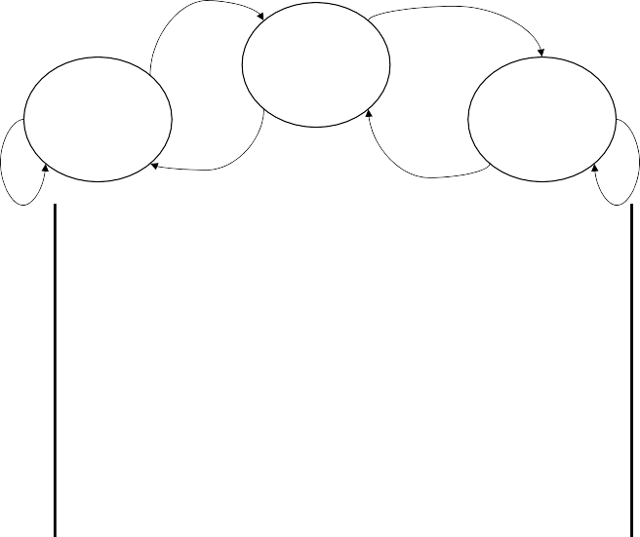
Let’s do Value Iteration
1/2
WIND
1/2
γ = 0.5
SUN

+4
→
HAIL
.::.:.::
-8
0
1/2
1/2
1/2
1/2
k | J^{k}(SUN) | J^{k}(WIND) | J^{k}(HAIL)
1
2
3
4
5
Copyright © 2002, 2004, Andrew W. Moore
Markov Systems: Slide 13
Let’s do Value Iteration
1/2
WIND
1/2
γ = 0.5
SUN

+4
→
HAIL
.::.:.::
-8
0
1/2
1/2
1/2
1/2
k | J^{k}(SUN) | J^{k}(WIND) | J^{k}(HAIL)
1 | 4 | 0 | -8
2 | 5 | -1 | -10
3 | 5 | -1.25 | -10.75
4 | 4.94 | -1.44 | -11
5 | 4.88 | -1.52 | -11.11
Copyright © 2002, 2004, Andrew W. Moore
Markov Systems: Slide 14

Slide 8
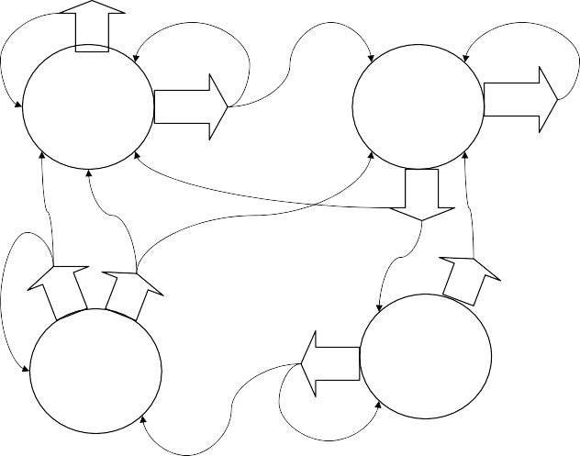
Value Iteration for solving Markov Systems
Compute J¹(S_{i}) for each j
Compute J²(S_{i}) for each j
:
Compute J^{k}(S_{i}) for each j
As k→∞ J^{k}(S_{i})→J*(S_{i}) . Why?
When to stop? When Max
J^{k+1}(S_{i}) – J^{k}(S_{i}) < ξ
i
This is faster than matrix inversion (N³ style) if the transition matrix is sparse
Copyright © 2002, 2004, Andrew W. Moore Markov Systems: Slide 15
A Markov Decision Process
1
You run a startup company.
In every state you must choose between
S
Poor & Unknown
+0
γ = 0.9
1/2
Poor & Famous
+0
1
A
1/2
A
1/2
1/2
S
1/2
1/2
1/2
1
Saving money or Advertising.
1/2
S
A
A
Rich & Unknown
+10
Rich & Famous
+10
1/2
1/2
S
Copyright © 2002, 2004, Andrew W. Moore
Markov Systems: Slide 16

Slide 9

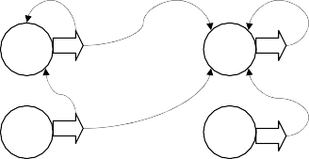
Markov Decision Processes
An MDP has…
A set of states {s₁ ··· S_{N}}
A set of actions {a₁ ··· a_{M}}
A set of rewards {r₁ ··· r_{N}} (one for each state)
A transition probability function
P = Prob(Next = j This = i and I use action k )
k
ij
On each step:
Call current state S_{i}
Receive reward r_{i}
Choose action ∈ {a₁ ··· a_{M}}
If you choose action a_{k} you’ll move to state S_{j} with
probability P^{k}
ij
4. All future rewards are discounted by γ
Copyright © 2002, 2004, Andrew W. Moore
Markov Systems: Slide 17
A Policy
A policy is a mapping from states to actions.
1
Examples
S
1
Policy Number 2: Policy Number 1:
STATE → ACTION
PU | S
PF | A
RU | S
RF | A
1/2
PU
0
PF
0
A
S
A
1
1/2
RU
+10
RF
+10
STATE → ACTION
PU | A
PF | A
RU | A
RF | A
1/2
PU A
0
1/2
1/2
PF A
0
1
RU A
1/2
RF
10
A
1
10
How many possible policies in our example?
Which of the above two policies is best?
How do you compute the optimal policy?
Copyright © 2002, 2004, Andrew W. Moore
Markov Systems: Slide 18

Slide 10
Interesting Fact
For every M.D.P. there exists an optimal policy.
It’s a policy such that for every possible start state there is no better option than to follow the policy.
(Not proved in this lecture)
Markov Systems: Slide 19
Copyright © 2002, 2004, Andrew W. Moore
Computing the Optimal Policy
Idea One:
Run through all possible policies. Select the best.
What’s the problem ??
Copyright © 2002, 2004, Andrew W. Moore
Markov Systems: Slide 20

Slide 11
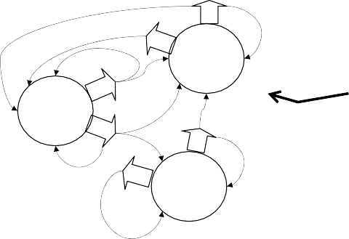
Optimal Value Function
Define J*(S_{i}) = Expected Discounted Future
Rewards, starting from state S_{i},
assuming we use the optimal policy
B
1 0
1
Question
What (by inspection) is an optimal policy for that MDP?
(assume γ = 0.9)
1/2
A
S
2
+3
S₁
+0
A
1/2
B
1/3
1/3
B
1/2
1/3
A
S₃
+2
1/2
1
What is J*(S₁) ? What is J*(S₂) ? What is J*(S₃) ?
Copyright © 2002, 2004, Andrew W. Moore
Markov Systems: Slide 21
Computing the Optimal Value Function with Value Iteration
Define
J^{k}(S_{i}) = Maximum possible expected sum of discounted rewards I can get if I start at state S_{i} and I live for k time steps.
Note that J¹(S_{i}) = r_{i}
Copyright © 2002, 2004, Andrew W. Moore
Markov Systems: Slide 22

Slide 12
Let’s compute J^{k}(S_{i}) for our example
k | J^{k}(PU) | J^{k}(PF) | J^{k}(RU) | J^{k}(RF)
1
2
3
4
5
6
Copyright © 2002, 2004, Andrew W. Moore
Markov Systems: Slide 23
Let’s compute J^{k}(S_{i}) for our example
k | J^{k}(PU) | J^{k}(PF) | J^{k}(RU) | J^{k}(RF)
1 | 0 | 0 | 10 | 10
2 | 0 | 4.5 | 14.5 | 19
3 | 2.03 | 6.53 | 25.08 | 18.55
4 | 3.852 | 12.20 | 29.63 | 19.26
5 | 7.22 | 15.07 | 32.00 | 20.40
6 | 10.03 | 17.65 | 33.58 | 22.43
Copyright © 2002, 2004, Andrew W. Moore
Markov Systems: Slide 24

Slide 13
Bellman’s Equation
r + γ P J (S )
⎡ ⎤
Copyright © 2002, 2004, Andrew W. Moore Markov Systems: Slide 25
J (S ) =
N
n+1
i
max
k
⎢⎣ i
∑
k n
j ⎥⎦
j =1
ij
Value Iteration for solving MDPs
…Also known as
Dynamic Programming
Compute J¹(S_{i}) for all i
Compute J²(S_{i}) for all i
:
Compute J^{n}(S_{i}) for all i
…..until converged
max
J (S )− J (S )⟨ξ
⎤
⎥⎦
⎡converged when
n+1
n
⎢⎣
i
i i
Finding the Optimal Policy
Compute J*(S_{i}) for all i using Value Iteration (a.k.a. Dynamic Programming)
Define the best action in state S_{i} as
⎡ ⎤
argmax
k
∑ ij
(S )
r + γ P J
⎢ i
k ∗
j ⎥
⎦
⎣
j
(Why?)
Copyright © 2002, 2004, Andrew W. Moore
Markov Systems: Slide 26

Slide 14
Applications of MDPs
This extends the search algorithms of your first lectures to the case of probabilistic next states.
Many important problems are MDPs….
… Robot path planning
… Travel route planning
… Elevator scheduling
… Bank customer retention
… Autonomous aircraft navigation
… Manufacturing processes
… Network switching & routing
Copyright © 2002, 2004, Andrew W. Moore
Markov Systems: Slide 27
Asynchronous D.P.
Value Iteration:
“Backup S₁”, “Backup S₂”, ···· “Backup S_{N}”, then “Backup S₁”, “Backup S₂”, ····
repeat :
: There’s no reason that you need to do the backups in order!
Random Order …still works. Easy to parallelize (Dyna,
Sutton 91)
On-Policy Order
Simulate the states that the system actually visits.
Efficient Order
e.g. Prioritized Sweeping [Moore 93] Q-Dyna [Peng & Williams 93]
Copyright © 2002, 2004, Andrew W. Moore
Markov Systems: Slide 28

Slide 15
Policy Iteration
Another way to compute optimal policies
Write π(S_{i}) = action selected in the i’th state. Then π is a policy. Write π^{t} = t’th policy on t’th iteration
Algorithm:
π˚ = Any randomly chosen policy
∀i compute J˚(S_{i}) = Long term reward starting at S_{i} using π˚
⎡
P J (S )
⎤
⎦
π (S ) =
arg max
a
r
+ γ ∑
j
a o
1 i
J₁ = ….
⎢ i
ij j
⎣
π₂(S_{i}) = ….
… Keep computing π¹ , π² , π³ …. until π^{k} = π^{k+1} . You now have an optimal policy.
Copyright © 2002, 2004, Andrew W. Moore
Markov Systems: Slide 29
Policy Iteration & Value Iteration: Which is best ???
It depends.
Lots of actions? Choose Policy Iteration Already got a fair policy? Policy Iteration Few actions, acyclic? Value Iteration
Best of Both Worlds:
Modified Policy Iteration [Puterman]
…a simple mix of value iteration and policy iteration
3rd Approach
Linear Programming
Copyright © 2002, 2004, Andrew W. Moore
Markov Systems: Slide 30

Slide 16
Time to Moan
What’s the biggest problem(s) with what we’ve seen so far?
Copyright © 2002, 2004, Andrew W. Moore
Markov Systems: Slide 31
Dealing with large numbers of states
Don’t use a Table…
STATE | VALUE
s₁
S₂
:
^{S}15122189
(Generalizers)
use…
(Hierarchies)
Splines
 | Variable Resolution
 |  |  |  |  |  |  | [Munos 1
 | Multi Resolution
999]
A Function Approximator
Memory Based
STATE
VALUE
Copyright © 2002, 2004, Andrew W. Moore
Markov Systems: Slide 32

Slide 17
Function approximation for value functions
Polynomials
Neural Nets
Backgammon, Pole Balancing, Elevators, Tetris, Cell phones
Splines
[Samuel, Boyan, Much O.R. Literature]
[Barto & Sutton, Tesauro, Crites, Singh, Tsitsiklis]
Checkers, Channel Routing, Radio Therapy
Economists, Controls
Downside: All convergence guarantees disappear.
Copyright © 2002, 2004, Andrew W. Moore
Markov Systems: Slide 33
Memory-based Value Functions
J(“state”) = J(most similar state in memory to “state”) or
Average J(20 most similar states) or
Weighted Average J(20 most similar states)
[Jeff Peng, Atkenson & Schaal, Geoff Gordon, proved stuff Scheider, Boyan & Moore 98]
“Planet Mars Scheduler”
Copyright © 2002, 2004, Andrew W. Moore
Markov Systems: Slide 34

Slide 18

Hierarchical Methods
Continuous State Space: “Split a state when statistically
significant that a split would
Discrete Space:
improve performance”
Continuous Space
Chapman & Kaelbling 92,
e.g. Simmons et al 83, Chapman & Knelbling 92, Mark Ring 94 …, Munos 96
McCallum 95 (includes hidden state)
A kind of Decision Tree Value Function
with interpolation!
“Prove needs a higher resolution”
Moore 93, Moore & Atkeson 95
Multiresolution
A hierarchy with high level “managers” abstracting low level “servants”
Many O.R. Papers, Dayan & Sejnowski’s Feudal learning, Dietterich 1998 (MAX-Q hierarchy) Moore, Baird & Kaelbling 2000 (airports Hierarchy)
Copyright © 2002, 2004, Andrew W. Moore Markov Systems: Slide 35
What You Should Know
Definition of a Markov System with Discounted rewards
How to solve it with Matrix Inversion
How (and why) to solve it with Value Iteration
Definition of an MDP, and value iteration to solve an MDP
Policy iteration
Great respect for the way this formalism generalizes the deterministic searching of the start of the class
But awareness of what has been sacrificed.
Copyright © 2002, 2004, Andrew W. Moore Markov Systems: Slide 36

